Slide 1
Making Healthcare Education Responsive to Student Needs in the COVID19 Crisis
April 16, 2020

Slide 2
Today’s Speakers
Moderators:
Iris Palmer & Ivy Love, CESNA, New America
Presenters:
Marianne Krismer & Debra Bragg, Health Professions Pathways (H2P) Consortium
Kenneth Wilson, John Cosgrove & Maggie Cosgrove, MoHealthWINs Consortium
Maria Fieth & Heather McKay, Consortium for Healthcare Education Online (CHEO)
Donna Meyer, Organization for Associate Degree Nursing

Slide 3
Federal Investment in Community Colleges

Slide 4
TAACCCT
$2 billion federal investment – USDoL
Four rounds of 4-year grants
Grants awarded to 2/3 of community colleges
Almost ½ million students
Over 350,000 credentials awarded

Slide 5
Community Colleges as Engines of Opportunity
Thank you to Lumina Foundation!
Meta-analysis:
  TAACCCT students are twice as likely to complete programs and almost 30% more likely to secure a credential
Briefs reveal in-depth implementation strategies for:
  Prior Learning Assessment
  Navigators

Slide 6
Health Professions Pathways (H2P) Consortium

Slide 7
The H2P Consortium
9 community colleges; 5 states (IL, KY, MN, OH, & TX)
Create and improve healthcare education, including core curriculum and holistic student supports
Nearly 5,000 students enrolled in 41 programs
  Largest programs: Certified Nursing Assistant, Practical Nursing, Registered Nursing, Medical Assistant, Pharmacy Technician, and Emergency Medical Technician
68% of H2P participants earned at least 1 credential or were still enrolled 3rd year of the TAACCCT grant

Slide 8
H2P : Featured Strategies
Recruitment and supports for underserved student populations
Partnerships to create and continuously improve career pathways
Employment engagement and partnerships
Work-based learning, including apprenticeships
Notes:
Partnerships were developed with National Healthcare Organizations such as National Network for Health Programs in Two Year Colleges, Health Professions Network and ANSI, The DOL Health Professions Competency Pyramid was revised in collaboration with NN2 and HPN
Regional Employer Collaboratives were developed using the Cincinnati Regional model to promote employer led initatives to meet health care employment needs of the region and to forecast future pipeline needs using regional and national trend data.
Work based learning imbedded for nursing, medical assisting, and sterile processing and others in development.
Employer

Slide 9
Lessons for COVID19
Reach out to employer and community partner networks – give and receive help
Ensure learning of critical skills and competencies via embedded pathway support
Reduce time to completion -- Get students into practice as quickly as possible via apprenticeships, early employment opportunities, etc.
Use data to improve (e.g., reduce time to completion)
Act now. It’s time to break barriers!
Notes:
Pathways with multiple on and off ramps: Work with High Schools, Employers, Community Organizations
Intentionally Imbed Student Support throughout pathway, ie: employers, secondary, post-secondary and other agencies as needed, also student initiated support networks
Reducing time to completion increases success, job experience also increases competetence and provides needed support and develops loyalty to the employer. Win/win!!
Use this time as an opportunity to think strategically and break all unnecessary barriers to creating a competent healthcare workforce. We need to realize that continued learning and increased competence comes with time, students are often ready to begin practice much earlier than the curriculum dictates.

Slide 10
MoHealthWINs Consortium

Slide 11
MoHealthWINs
12 community & 1 technical colleges in Missouri
Online learning; stackable credentials; contextualized learning; hands-on labs; accelerated, chunked, modularized curriculum; enhanced advising; career pathways, dev ed redesign; and employer engagement
Nearly 4,250 students enrolled in 60 programs
  Largest programs: Certified Nursing Assistant, Maintenance, Certified Med Tech, Pharmacy Tech, Electronic Health Records
88% credit hours attempted were completed
75% of completers who started as unemployed secured employment upon completion

Slide 12
Featured Strategies
Course/Program Structure
Technology Enhanced Content
Enhanced Advising/Student Supports (Navigate)
Employer Engagement
Course Contextualization

Slide 13
Lessons for COVID19
Connect to students
  We are not giving them an education, they are seeking a career. Navigate!
Dare to innovate
  Easiest program to transition was a MHW program
Collaboration is key
  Non-credit to credit collaboration
Out work the barriers

Slide 14
Consortium for Healthcare Education Online (CHEO)

Slide 15
The CHEO Consortium
Purpose: Increase access to healthcare programming in rural states via hybrid and online opportunities
Round 2 Project Spanning 5 States (Pueblo CC - Lead)
Created 21 New or Revised Programs
Exceeded UP Target by 251%
Exceeded Wage Increase Target by 196%
3,037 Completers
Developed 6 Articulation Agreements
Created Innovative Approaches to Online Learning
  - Web-based Science Labs, Mobile Learning Labs, Flipped Classes, Open Educational Resources
Notes:
Creative Approaches: Lab continues to run out of MT, EMS/EMT Ambulance lab, Flipped Classroom story, Simulation experiences and equipment
CHEO materials downloaded over 270,000 times out of SkillsCommons

Slide 16
Featured Strategies
Innovations in remote learning for healthcare
  Online science labs
  Mobile learning labs
  New technologies and techniques
Employer partnerships
Stackable Credentials
Career coaching and navigation

Slide 17
Lessons for COVID19
Events (TAACCCT or COVID) may ignite institutional change - keep it going
Healthcare and science education can be taught online
Use strategies to move students through career pathways
Support faculty and administrators
Acceleration is key
Build sustainable employer partnerships
Notes:
1.
2.
3.
4. Support Faculty and Admin using: IDs, small successful steps, OER opportunities, EM Story
5. Course Acceleration to help move into workforce efficiently and sustainably, increasing wages
6. Partnerships: Sector Partnerships, include employers input regarding labor market needs, training needs and adjust curricula accordingly

Slide 18
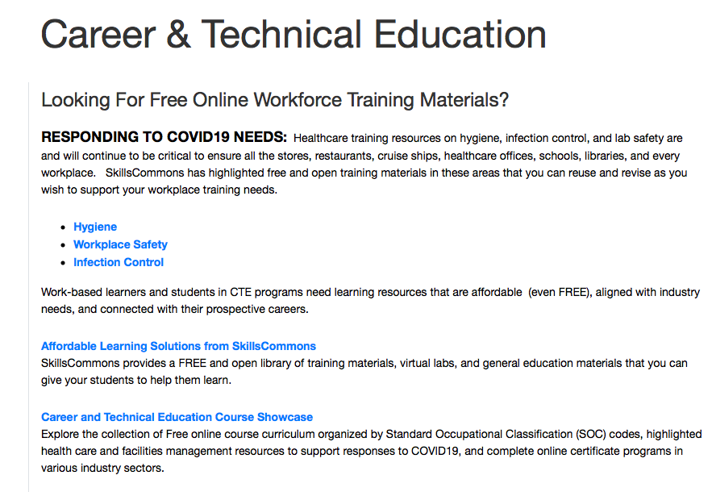

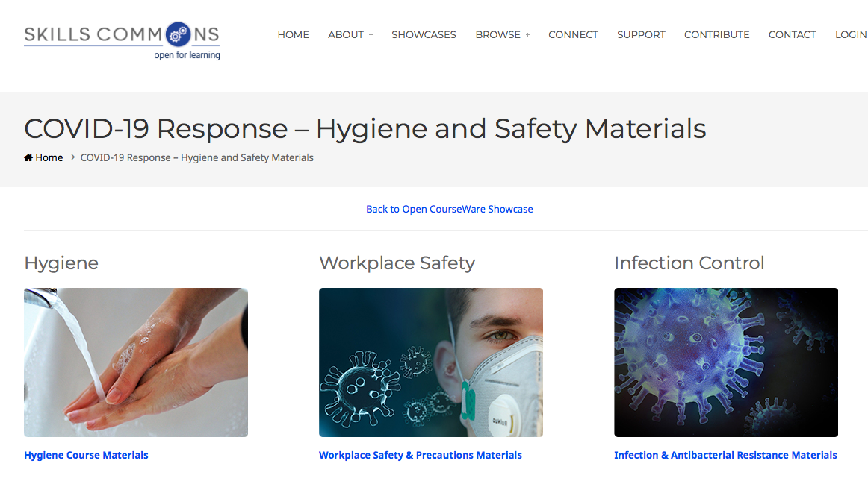
Open Educational Resources
Nearly 2.5 Million Downloads
COVID-19 Response Site:
Teaching and Learning Online
Hygiene, Safety, Infectious
Materials Courses
COVID-19 Response –
Hygiene and Safety Materials
Notes:
www.SkillsCommons.org
SkillsCommons and MERLOT Online Learning and Teaching Site https://www.merlot.org/merlot/viewSite.htm?id=9160704
Courses Site http://support.skillscommons.org/showcases/open-courseware/covid-19/
Contributions from projects such as Health Careers Work! out of GA Tech College; OHIO Tech Net (OSHA training); H2P - Maryann and Deb’s project described earlier; HL-SCI Connecticut: NPCCC - Pennsylvania; HSC244 - California; and others

Slide 19

Organization for Associate Degree Nursing (OADN)

Slide 20
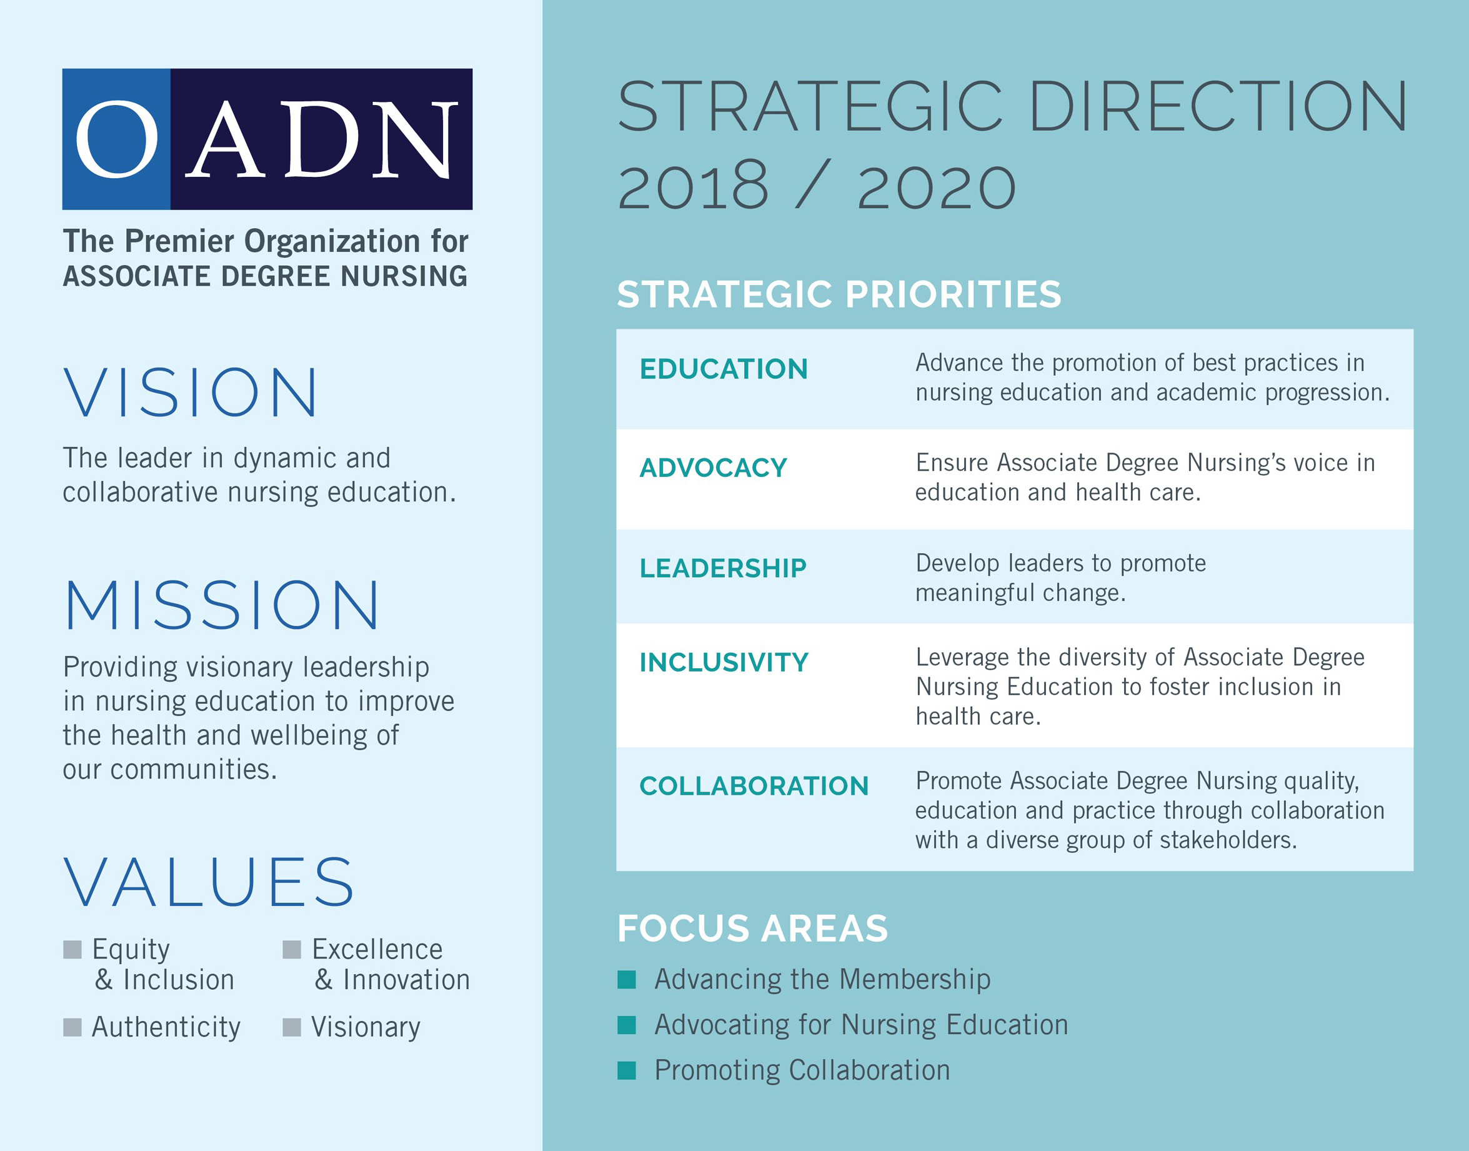

Slide 21

Featured Strategies
Simulation
Digital Classroom
Webinars
Collaboration
Policy Briefs
Media
Advocacy

Slide 22
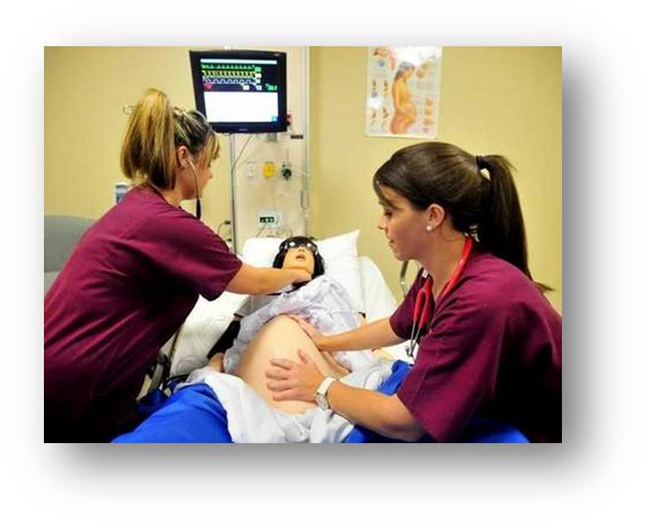
Lessons for COVID19
Simulation
Clinical Placements
Curriculum
Health Compliance
Quality and Safety
Nursing Workforce

Slide 23
Questions?

Slide 24
Speaker Contact Information
Ivy Love love@newamerica.org
Iris Palmer palmer@newamerica.org
Debra Bragg bragg.associates.inc@gmail.com
Marianne Krismer mkrismer61@gmail.com
Kenneth Wilson kwilso20@jeffco.edu
Maggie Cosgrove maggie@cosgroveandassociates.com
John Cosgrove john@cosgroveandassociates.com
Heather McKay hmckay@smlr.rutgers.edu
Maria Fieth maria@fieth.consulting
Donna Meyer donna.meyer@oadn.org

Slide 25




Keep in Touch!
newamerica.org/EPPnewsletters
@NewAmericaEd
Education Policy Program at New America
New America

