Slide 1

Tim Male, Executive Director tmale@policyinnovation.org

Slide 2
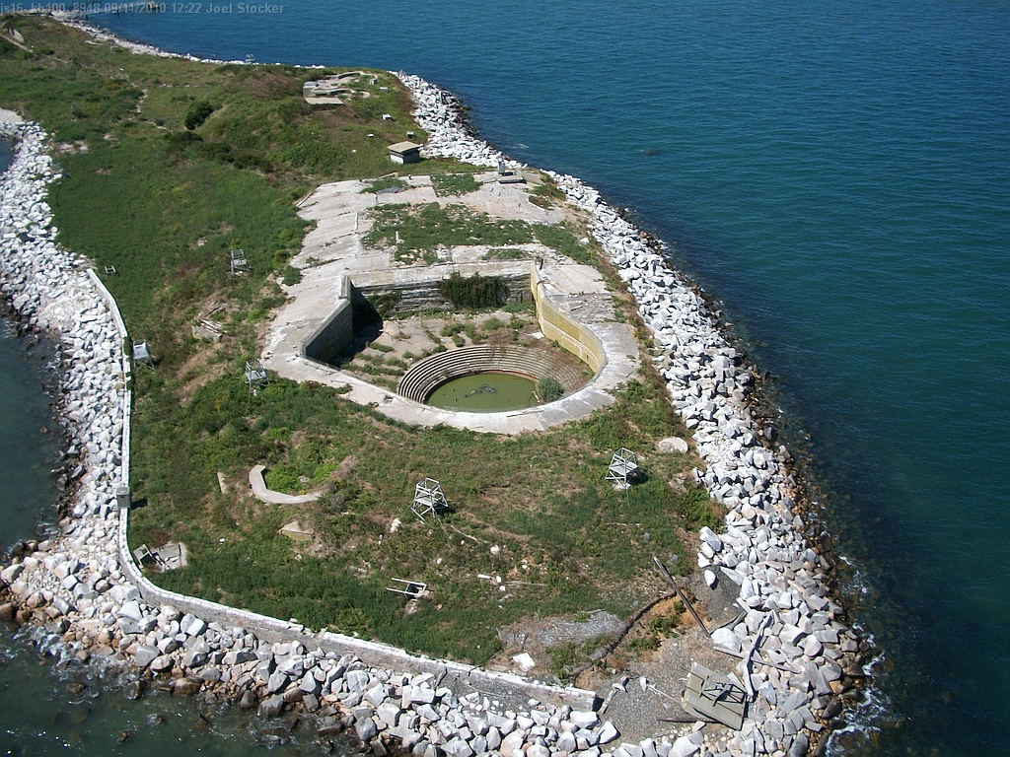

Slide 3
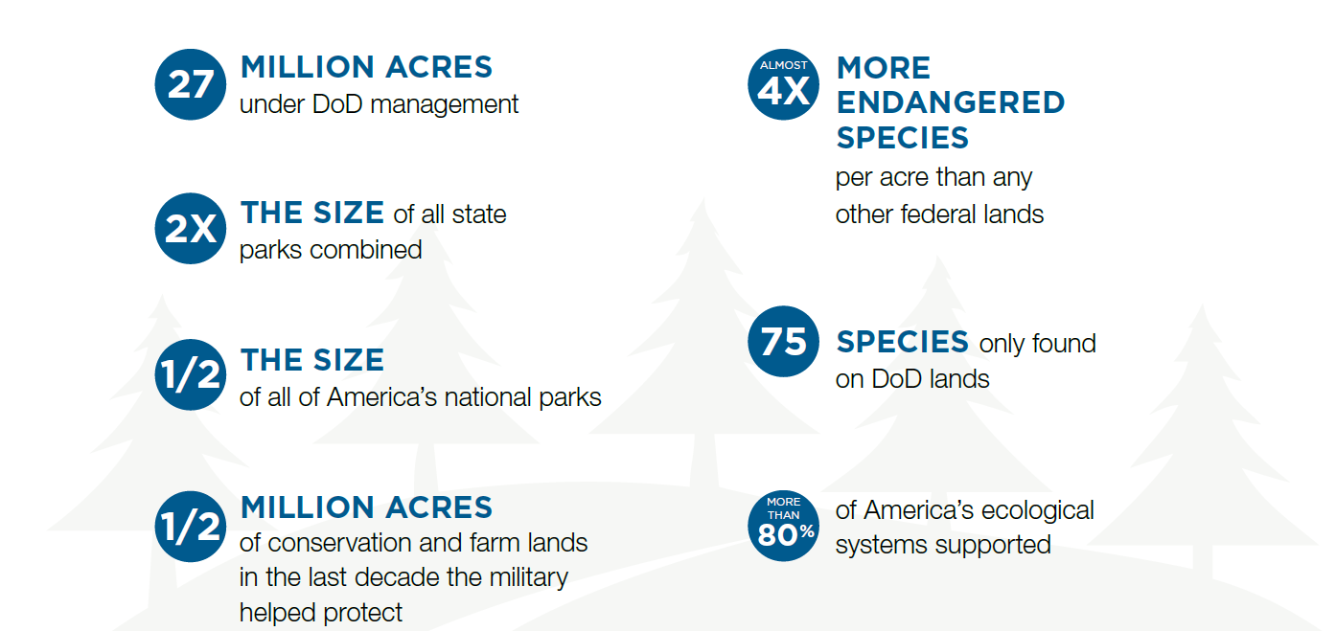
Importance of DoD to Conservation
Notes:
Tim

Slide 4
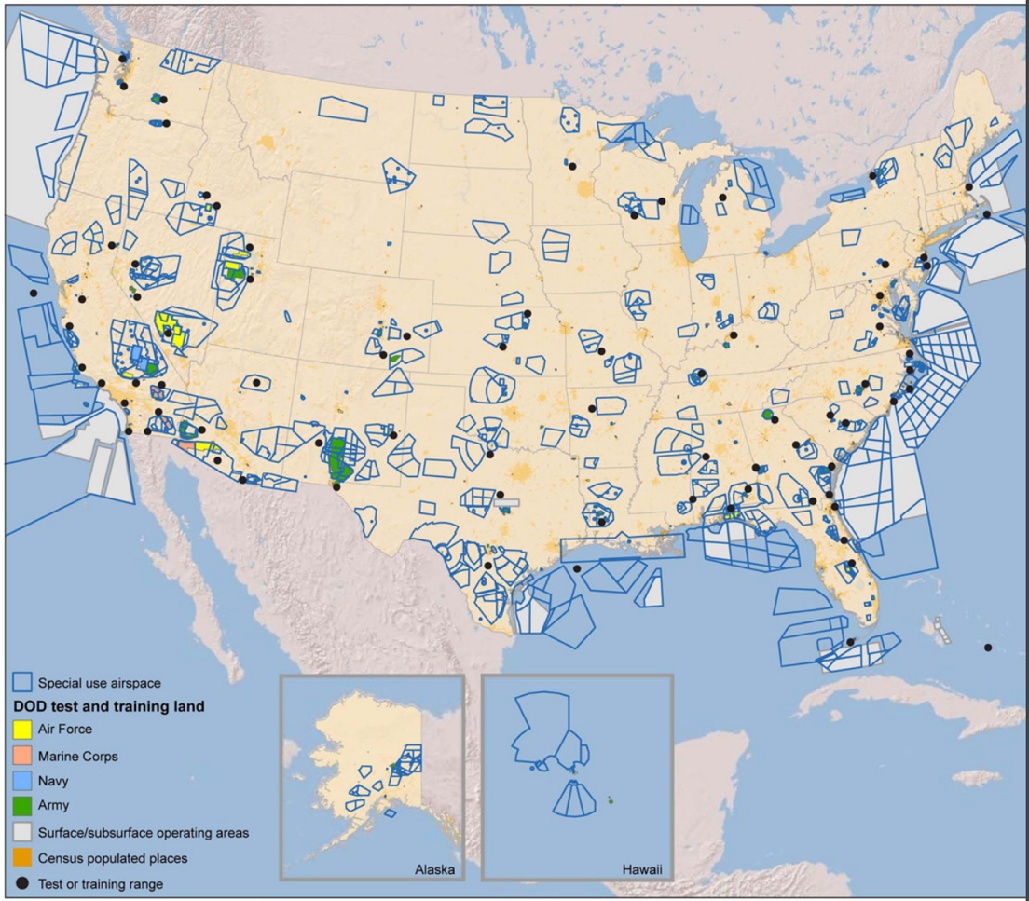
“The more that non-military lands are managed for wilderness or other conservation uses, the better it is for the Department of Defense.”
Notes:
Jake

Slide 5

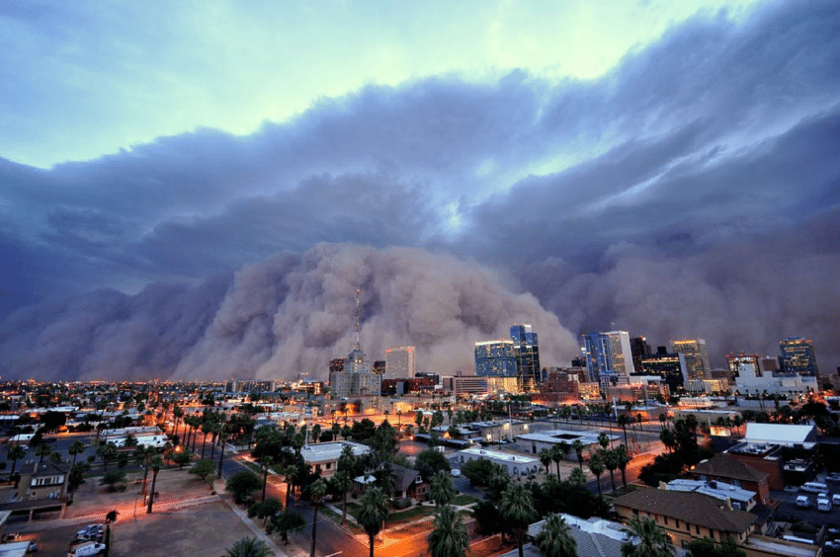
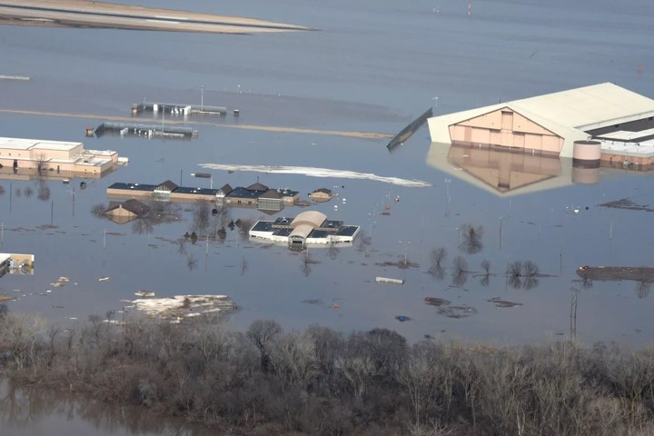
Notes:
Tim

Slide 6
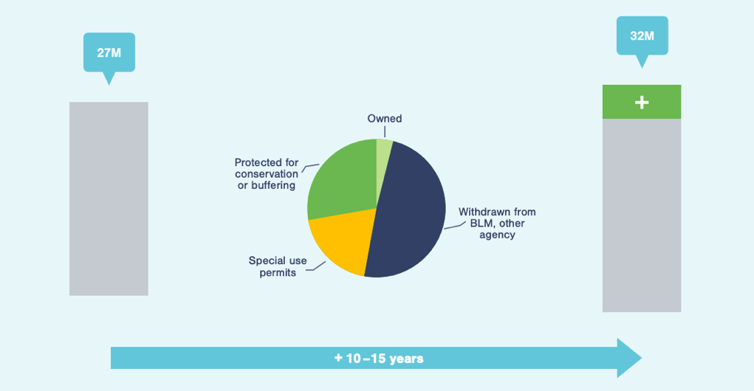
Assumptions
More space for future training and testing
Encroachment threat continues
Notes:
Jake

Slide 7
DoD Land Withdrawal Analysis
Conservationists need a framework for evaluating whether DoD might be a better conservation land manager than other federal agencies
Take BLM lands out of extractive uses?
Can wildlife corridors be protected through withdrawal?
What about loss of public access?
Expected funding levels?
Level of use/active training v passive buffering?
Create better natural resource planning and management standards and requirements for withdrawn lands – Barry Goldwater Range (AZ)
Notes:
Tim

Slide 8
Endangered Species Regulatory Incentives
New DoD initiatives for endangered species and training
ESA policies need to be amended to encourage wildlife recovery, give DoD predictability.
Can create many more acres of well-managed buffer habitat around installations in exchange for training flexibility on them.
Notes:
Jake

Slide 9
Landscape Scale Conservation
More tools needed to allow pooling of funds across federal agencies:
Use the National Fish and Wildlife Foundation
Create a military conservation foundation with legislation
Have White House CEQ manage funds
Pool funds through a private foundation (e.g. US Endowment for Forests
Create a White House task force on national defense and conservation

