Slide 1

Conservation Partnering
Rebecca R. Rubin, Marstel-Day LLC
June 18, 2020
Through Encroachment Planning

Slide 2
DoD’s Epic Shift
From Federal Fortress Paradigm… To Conservation Community Collaboration
Pioneering approaches to environmental stewardship & mission readiness

Slide 3
Envisioning Success
Conservation community helped define need/create market
Led to so-called Encroachment Partnering Legislation 10 U.S.C. 2684 (a)
Inspiration for a formal conservation partnering program

Slide 4
Encroachment Partnering
Enables DoD partnerships with non-federal entities
10 U.S.C. 2684 (a)

Slide 5
Growth of Partnering
Risk-based approaches
Conservation partners, states, local communities and others
Additional partnerships - water resources, energy security, climate change and more

Slide 6
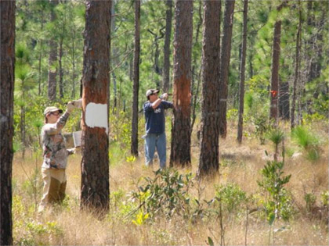

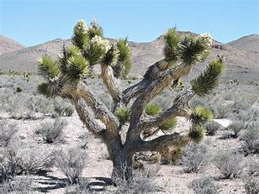
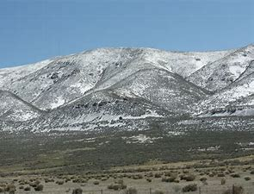
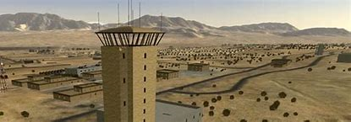
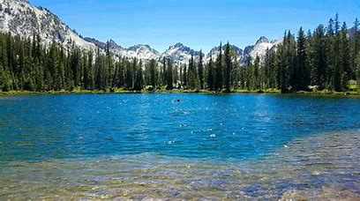
Marquee Moments - Encroachment Planning

Slide 7
What Lies Ahead?
“Conservation Mosaic” approach
Greater coordination among federal land managers
Multi-jurisdictional strategies

Slide 8
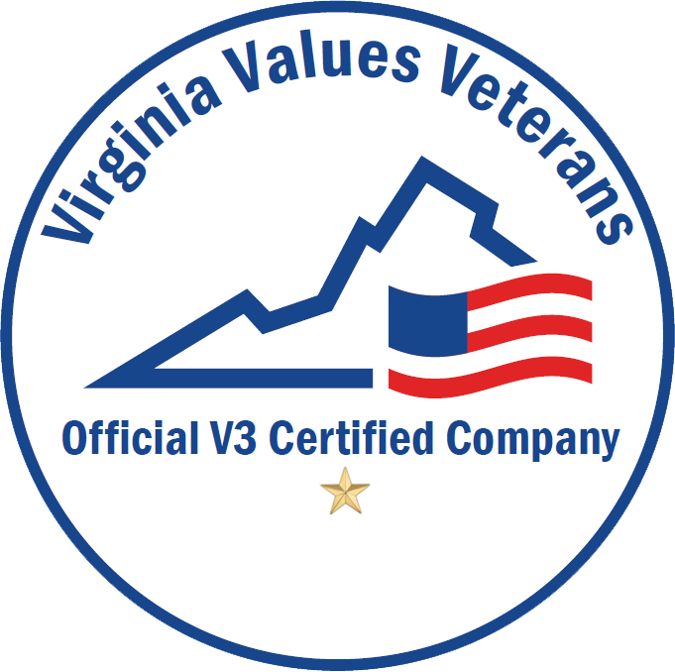



For Questions or More Information
Rebecca Rubin
President & CEO, Marstel-Day LLC
Phone
703-839-5512
Email
RRR@Marstel-Day.Com

