Slide 1
Point-to-Multipoint Broadband Opportunities in the 3700-4200 MHz Band
March 27, 2018

Slide 2


Proposed Win-Win-Win for C-band Combining the BAC Proposal with the Intelsat/SES/Intel Proposal
Mobile
Opens 100 MHz of spectrum at 3700 – 3800 MHz for mobile 5G in densely-populated urban areas
May enable some level of global harmonization
Satellite
Compensation to clear portion of band
Protects incumbent FSS providers
Wireless Broadband (Fixed Wireless)
Leverages unused FSS geography and frequencies
Enables delivery of 25 Mbps -> 1 Gbps service to rural & residential unserved and underserved communities

Slide 3
Key Points of the BAC Sharing Proposal
Provide access for mobile 5G in the 3700 – 3800 MHz band in densely populated urban areas
Provide access for P2MP broadband in frequency- and geography-coordinated spectrum across:
3800 – 4200 MHz band and
3700 – 3800 MHz band outside densely populated urban areas
Protect incumbent FSS providers from harmful interference

Slide 4
BAC & Intel/SES/Intelsat Proposals can be Combined and are Complementary
The proposals are not inconsistent with one another
As a stand-alone proposal, the Intelsat/SES/Intel proposal will do nothing to close the digital divide
It will not facilitate broadband service to unserved and underserved rural communities

Slide 5
A Technical Analysis of Band Sharing Must be Performed with Proper Assumptions
Technical characteristics of P2MP are quite different than mobile service
SES technical analysis not directly applicable to P2MP coexistence
Fixed wireless base stations typically operate on a directional, sectorized basis.
Mobile base stations use multiple antenna sectors to create omnidirectional coverage
Not all earth stations use all 500 megahertz of the C-band
Exclusion zones vary widely for co-channel versus adjacent channel sharing
Co-channel: 60 – 75 km
Adjacent channel: “a few to several km,” worst case
SES assumes power levels that are higher than BAC proposed
SES assumes antenna heights that are higher than required for many P2MP operations

Slide 6

Protecting the Holes in the Swiss Cheese
Coordinating P2MP to avoid FSS interference
Geographic & LOS
Unused Frequencies
With improved IBFS data and a proper technical study to protect FSS earth stations, there’s a lot of potential “cheese” left for rural broadband
FSS Protection Zones
Fixed Wireless Opportunity

Slide 7
Large Scale Rural Example

Slide 8
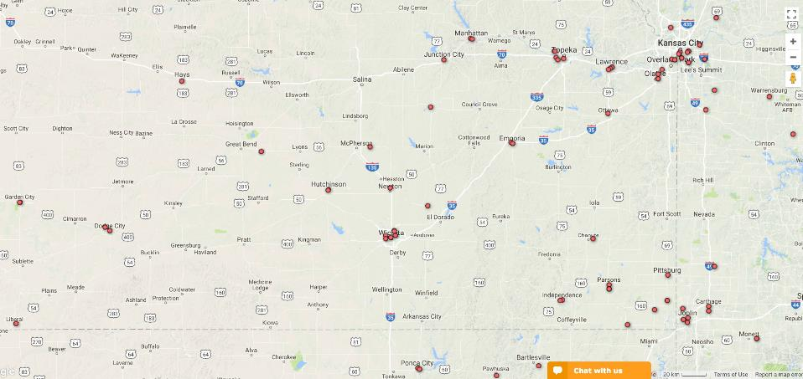
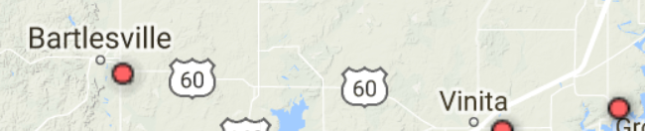
Rural Kansas Registered FSS Sites

Slide 9
Co-Channel 65km Zones – Geographic Cheese
Assumptions
Showing 100% LOS
No terrain blockage
Full arc 360º protection
No orbital position data
Full 500 MHz protection

Slide 10
Adjacent Channel 3km Zones – Frequency Cheese
To avoid LNB saturation, coordination can be done at below noise floor levels at FSS receivers on unused frequencies
Assumptions
100% LOS
No terrain blockage
Full arc 360º protection

Slide 11
Conclusions: Co-Channel
Co-channel sharing with large (worst-case) protection zones provides some rural opportunities
With ITM (Irregular Terrain Model) and directional sector coordination, significant additional areas can be coordinated for P2MP fixed wireless

Slide 12
Conclusions: Adjacent Unused Channels
IBFS update needs to include frequencies in actual use by earth stations
Sub-3km protection zone and interference protection to prevent any LNB saturation
Handling FSS transponder/frequency changes:
Near-term: fixed wireless coordination and channel changes can be accomplished with simple notification (e.g., similar to Part 96 process)
Potential future database option to automate channel changes

