Slide 1
Point-to-Multipoint Coexistence with C-band FSS
March 27th, 2018
Notes:
A tutorial that covers the technical issues

Slide 2
Conclusions
3700-4200 MHz point-to-multipoint (P2MP) systems could immediately provide gigabit-class broadband service to tens of millions of Americans, without causing disruption to FSS
  In many areas of the country, P2MP systems can operate in C-band (3700-4200 MHz) without causing interference to co-channel fixed-satellite service (FSS) systems
  Co-channel sharing is possible by considering geographic and directional isolation between P2MP and FSS; that is, operating in areas with a relatively low number of earth stations, and using directional antennas that don’t point toward earth stations in the area.
If actual FSS frequency use were known, frequency separation could allow 25 Mbps - 1 Gbps P2MP broadband service to as many as 120 million Americans
Notes:
If only co-channel is considered, we could provide broadband service virtually immediately to tens of millions of Americans.
If non-co-channel operation is considered, that number expands to as many as 120 million Americans, depending on actual FSS frequency use, which is unknown.

Slide 3
Contents
Considerations for coexistence between P2MP and FSS
Areas in which P2MP and FSS may be able to co-exist
Real-world example: Co-channel & non-co-channel
Notes:
We’ll look at a high-level overview of the co-existence issues
followed by an examination of how much of the country is ripe for sharing
and then dive into a more detailed analysis based on an actual deployment.

Slide 4
Coexistence Considerations

Slide 5
FSS 2
FSS 3
FSS 1
P2MP CPE 1
P2MP CPE 2
FSS 4
FSS 6
P2MP CPE 3
P2MP Base
FSS 5
Notes:
Cartoon overview
P2MP base bottom center
Sectorized antenna, beam shown in green
Serves a number of homes represented by “Customer Premise Equipment,” which transmit on the same frequency back to base (blue beams)
Several FSS earth stations in the area
Can they all co-exist? Let’s look at the factors that go into the determination.

Slide 6
Calculation of Co-channel Interference from P2MP into FSS
Assume n P2MP transmitters operating within C-band, with conducted power spectral densities of PSD_{i} (in dBm/MHz). The aggregate interference power spectral density IPSD_{j} (dBm/MHz) received by FSS station j is:
IPSD_{j} = ∑(PSD_{i} + GT_{i,j} − PL_{i,j} + GR_{i,j}),
where:
GT_{i,j} = Gain of P2MP antenna i in the direction of FSS earth station j
PL_{i,j} = Propagation loss from P2MP station i to FSS earth station j
GR_{i,j} = Gain of FSS earth station j’s antenna in the direction of P2MP station i
n
i = 1
Notes:
Basic formula for determining co-channel coexistence
The interference contribution for each P2MP node as received by a given earth station depends on …
Total interference power at each earth station j is the sum of the contributions from each of the P2MP nodes

Slide 7
Propagation Loss
For analysis, PL is modeled by the NTIA Irregular Terrain Model (ITM) implementation of Longley-Rice
  Same model adopted by WInnForum for protection of FSS due to Part 96 CBRS
Very conservative model for interference prediction
  Does not specifically take clutter (trees and buildings) into account
  Extensive propagation testing in 3.6 GHz band shows clutter creates very high additional losses over ITM
  Measured losses in urban and suburban environment are some 40-60 dB greater than ITM, due to buildings and foliage
  Measured losses in rural environments have shown an additional ~17 dB/km of loss over ITM predictions, due to foliage
Used WInnForum-compliant implementation of ITM for propagation analysis
Notes:
We use ITM. It’s a very conservative model because it doesn’t specifically take clutter into account, as we determined from millions of propagation loss data points, which exceed ITM by 40-60 dB on average.
For ITM, think of Manhattan analogy.

Slide 8
P2MP/FSS Coexistence Criterion
Coexistence is achieved when the aggregate interference from planned P2MP deployments does not exceed the interference limit of any FSS earth station in the area
  The “area” can be defined by a distance beyond which interference into FSS reaches an inconsequential level
  This analysis considered FSS earth stations out to a distance of approximately 100 km
We use a co-channel FSS interference limit (expressed in power spectral density) of −129 dBm/MHz, which is the same limit used to protect co- and adjacent-band FSS in the CBRS band (e.g., 47 CFR 96.17(a)(2))
Coexistence criterion:
max(IPSD_{j}) ≤ −129 dBm/MHz
j
Notes:
Co-existence means that all FSS in the areas meet an aggregate power spectral density interference limit of -129 dBm/MHz
Same limit as used for CBRS

Slide 9
Factors that Strongly Influence Coexistence (GT_{ij}, PL_{ij}, GR_{ij})
Terrain blockage between P2MP and FSS creates high propagation loss, reducing interference power received by FSS (affects PL_{ij})
Low height of P2MP antennas (affects PL_{ij})
  Most customer premise equipment is located at relatively low heights above ground level, increasing propagation loss and reducing their interference impact on FSS
The use of directional P2MP antennas (affects GT_{ij})
  P2MP antenna discrimination reduces interference to FSS earth stations outside the P2MP beam.
FSS beam discrimination (affects GR_{ij})
  FSS antennas are generally pointed upward, with low gain towards the horizon, where P2MP systems are located
Low height of some FSS antennas (affects PL_{ij})
  While some FSS antennas are on rooftops, many are mounted on the ground, since they only need to see the sky. When mounted low to the ground, propagation losses to terrestrial systems are higher, reducing interference
Frequency separation will provide additional isolation (discussed later)
Notes:
Factors that influence the key variables in the interference equation (slide 6)

Slide 10
FSS 2
FSS 3
FSS 1
FSS 1: Protected by terrain (PL) | FSS 4: Pointing away from P2MP + distance (GR, PL)
FSS 2: Well outside of any P2MP beams (GT) | FSS 5: Outside but near P2MP beams (GT, PL, GR)
FSS 3: Well outside of any P2MP beams (GT) | FSS 6: Inside P2MP base beam (GT, PL, GR)
P2MP CPE 1
P2MP CPE 2
FSS 4
FSS 6
P2MP CPE 3
P2MP Base
FSS 5
Notes:
Revisit cartoon, with an examination of the factors that influence whether co-existence can be achieved.

Slide 11
P2MP Data that Enter into Coexistence Calculation
Required minimum information for each P2MP node (base and CPE)
  Location (lat/lon)
  Conducted power spectral density, including any cable losses between transmitter and antenna
  Antenna pointing azimuth and elevation
  Antenna beam pattern (i.e., gain as a function of azimuth and elevation)
  Height of ground above mean sea level
    Determined by lat/lon combined with a terrain database
  Antenna height above ground level
  Frequency and bandwidth of P2MP signal (for non-co-channel analysis)
  Out-of-band emission levels (for non-co-channel analysis)
Additional considerations
  Clutter impacting propagation
Notes:
Skim

Slide 12
FSS Data that Enter into Coexistence Calculation
Required minimum information for each FSS earth station
  Location (lat/lon)
  Antenna pointing azimuth(s) and elevation(s)
    Can be determined by orbital slot (or range of orbital slots) received by the earth station, combined with the earth station’s lat/lon
  Antenna beam pattern (i.e., gain as a function of off-axis angle)
  Height of ground above mean sea level
    Determined by lat/lon in combination with terrain database
  Antenna feed point height above ground level (reference point for interference calculation)
  Actual operating frequencies of the FSS receiver (for non-co-channel analysis)
Additional considerations
  Clutter impacting propagation
Notes:
What are the minimal necessary FSS data elements needed to compute co-existence?

Slide 13
Where could Co-channel FSS and P2MP Co-exist?
Notes:
Even without specific P2MP deployment data, it’s clear that geographic separation between P2MP and FSS is one of the key factors in determining coexistence.
We can take a general look at FSS deployments with respect to U.S. population to gain a better understanding of areas that are amenable to coexistence.

Slide 14
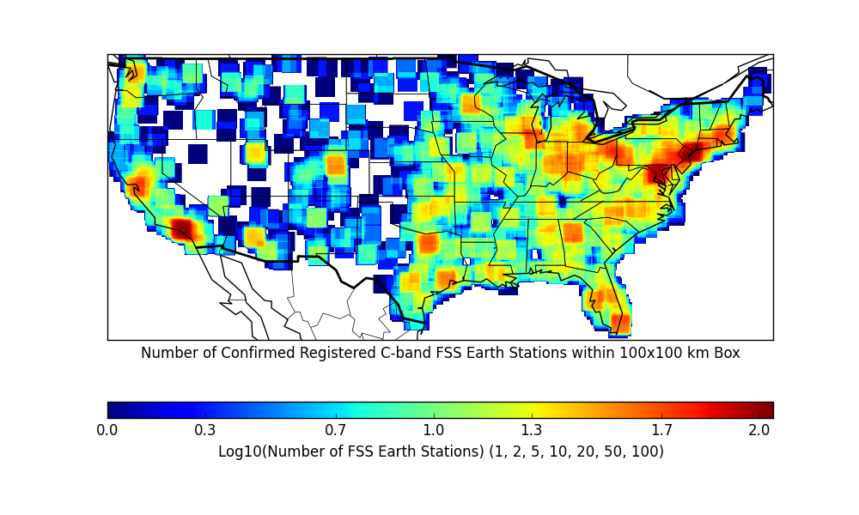
For each point in a 30 arc sec grid, this map displays the number of confirmed registered FSS earth stations within a
100x100 km box centered on the grid point. Source: FCC IBFS plus confirmation based on a 2014 Google Earth study.
Notes:
FSS roughly follows population -- densely populated urban areas have the highest density of earth stations, and therefore generally not as amenable to P2MP deployments.

Slide 15
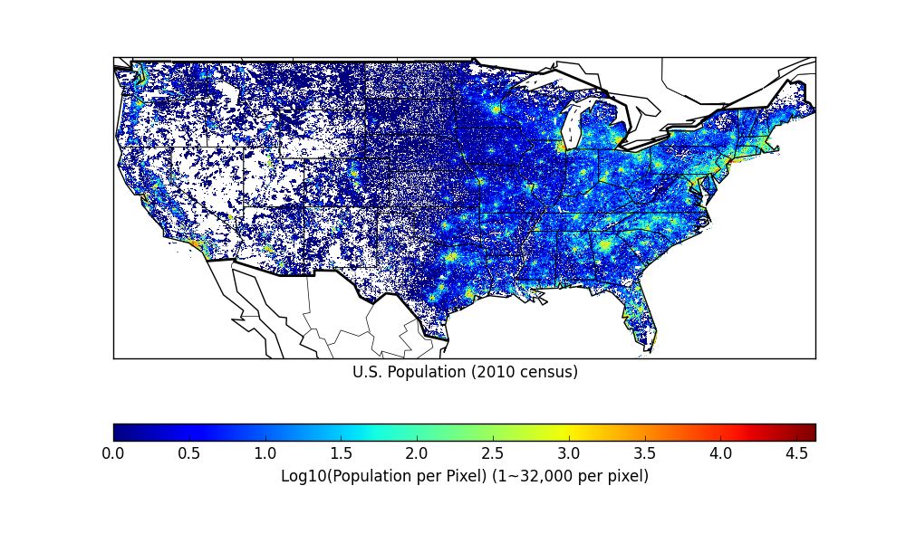
Each pixel is 30x30 arc seconds = ~0.75 km² depending on latitude. White = 0 population in the pixel.
Population density >0 and ≤1 per pixel clipped at 1 for display. Data derived from U.S. Census Bureau statistics.

Slide 16
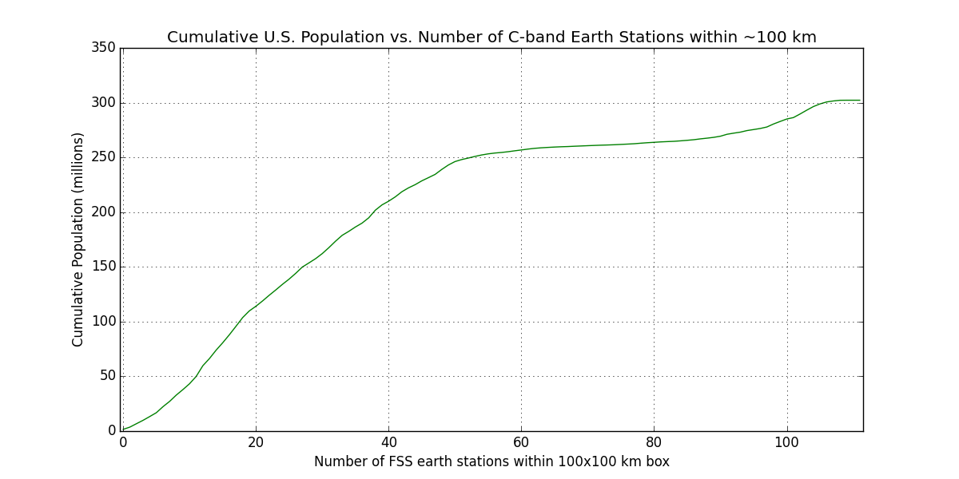
More than 100 million Americans have 20 or fewer registered earth stations within ~100 km
Notes:
The fewer the number of earth stations to coordinate against, the more likely there will be success in P2MP coordination.

Slide 17
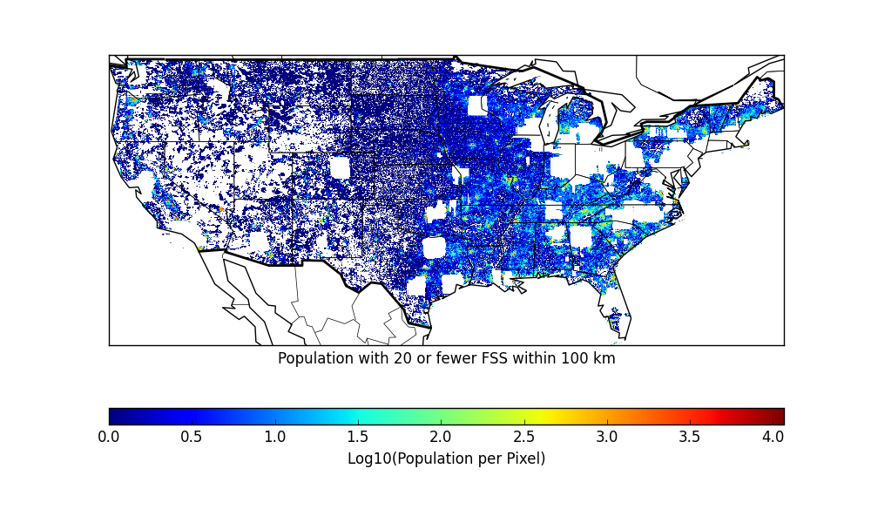
More than 100 million Americans have 20 or fewer registered C-band Earth stations within approximately 100 km
114 million Americans
Notes:
White areas are either no-go zones, either because of zero population, or areas with more than 20 fss in 100 km square box.
Generally blocked coastal areas are due to number of FSS, while areas in the central desert are lack of population.

Slide 18
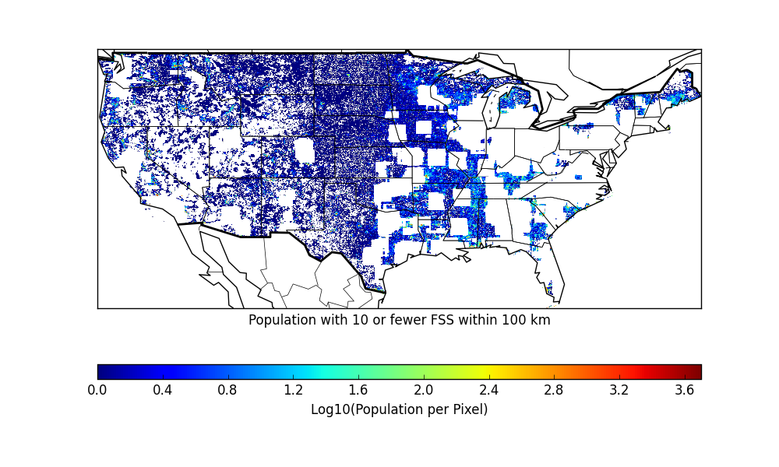
More than 100 million Americans have 20 or fewer registered C-band Earth stations within approximately 100 km
43 million Americans

Slide 19
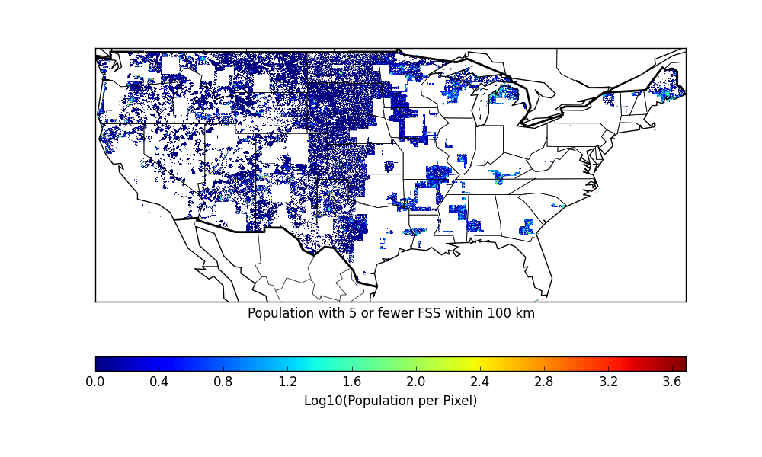
More than 100 million Americans have 20 or fewer registered C-band Earth stations within approximately 100 km
17 million Americans
Notes:
Prime areas for P2MP and FSS co-existence include a high percentage of underserved rural areas

Slide 20
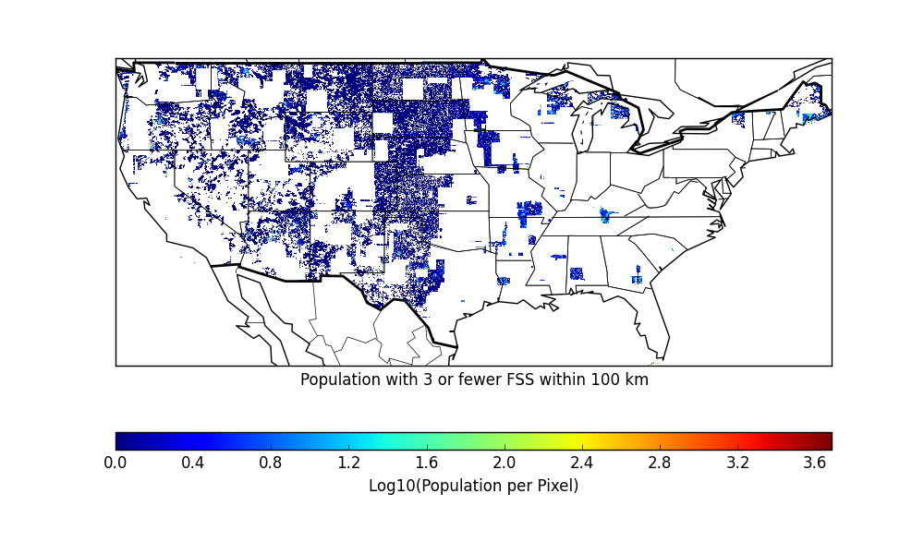
More than 100 million Americans have 20 or fewer registered C-band Earth stations within approximately 100 km
10 million Americans
Notes:
Interesting “blue holes” with reasonably large populations but extremely low density of FSS (e.g, between Huntsville AL and Chattanooga TN; and near Savannah/Brunswick GA, among others).

Slide 21
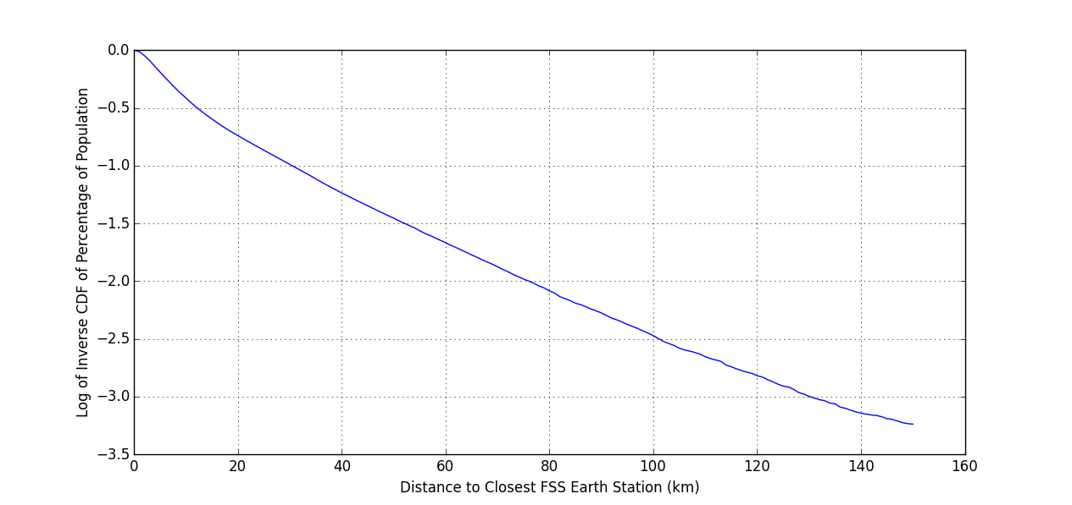
Distance to Closest FSS C-Band Earth Station
10% of U.S. population (~30 million people) lives farther than 30 km from the nearest registered C-band FSS earth station
Notes:
Fraction of population (left side, on a log scale) that lives farther than a given distance from the closes FSS earth station

Slide 22
Actual Co-channel Coexistence Example

Slide 23
Real-world Deployment
Based on overlay/replacement of current 5 GHz (unlicensed) deployment now providing point-to-multipoint broadband service in California just outside of the Bay area
The current deployment, without modification, was analyzed to determine if it could be replaced with, or complemented by, a system utilizing C-band (co-channel with FSS) to provide improved broadband service
This example is not “cherry-picked”
  Existing system deployed prior to, and without regard for, and considerations related to C-band FSS
Notes:
Region falls in a yellow area in slide 14

Slide 24
Analysis Procedures
Pull IBFS list of registered 3700-4200 MHz FSS earth stations within
150 km of P2MP area of operation
Validate the existence and operation of the registered sites
  Perform historical Google Earth imagery search for FSS antennas. Determine if antennas currently exist, or were removed in the past, or never existed, at or within ~1 km of registered coordinates
  Drive by sites for further information gathering. Confirm no dishes are in place, or, if so, determine if dishes are actually in use. In some cases, talk to the dish owner or the owners of the building on which the dish is mounted to determine status.
  If antenna(s) exist, correct antenna coordinates based on (a) and (b)
Gather all required operational data for P2MP and FSS (i.e., slides 11 & 12)
Compute best- and worst-case aggregate interference at each FSS earth station as a function of pointing, across its registered GSO arc range, in 1 deg increments
Based on actual P2MP and FSS operations, determine if coexistence criterion is met
  If not, determine if simple solutions or mitigating factors can achieve the coexistence criterion

Slide 25
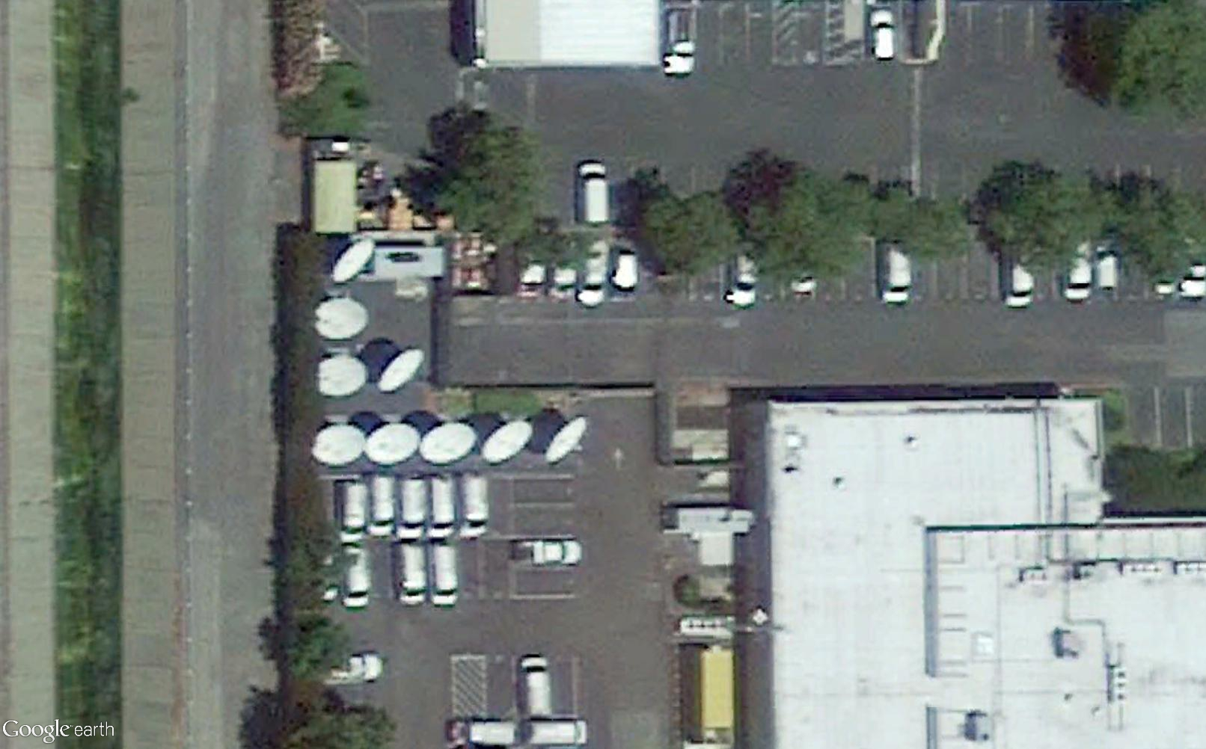
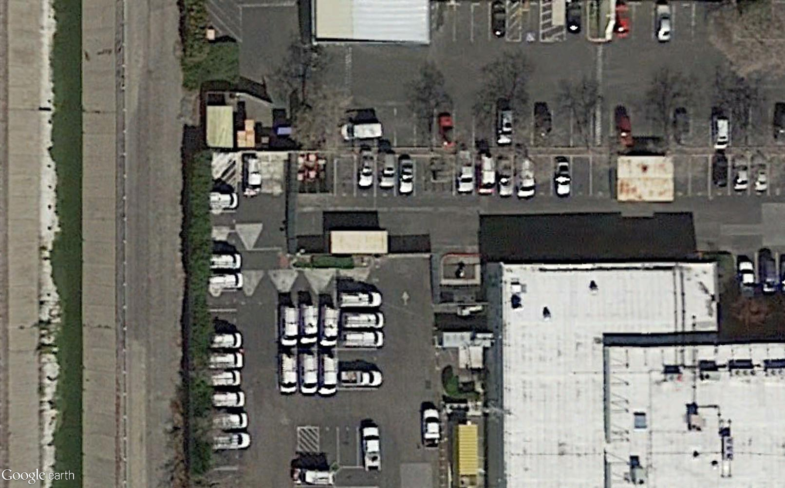
FSS Earth Station Registration Validation
37 registered FSS earth station sites were found in IBFS
  All are full-band registrations (3700-4200 MHz)
Of the 37 sites, Google Earth analysis and in-person visits determined that 21 of the registrations (57%) are not valid
  12 could not be found in any historical imagery back to the 1990s
    11 of the 12 belong to one licensee
  8 were previously removed (see one example below)
  1 exists but is no longer in operation (confirmed by in-person visit)
June 2013
February 2014
Notes:
This slide demonstrates why FSS validation is an important part of the analysis (perhaps the most important)

Slide 26
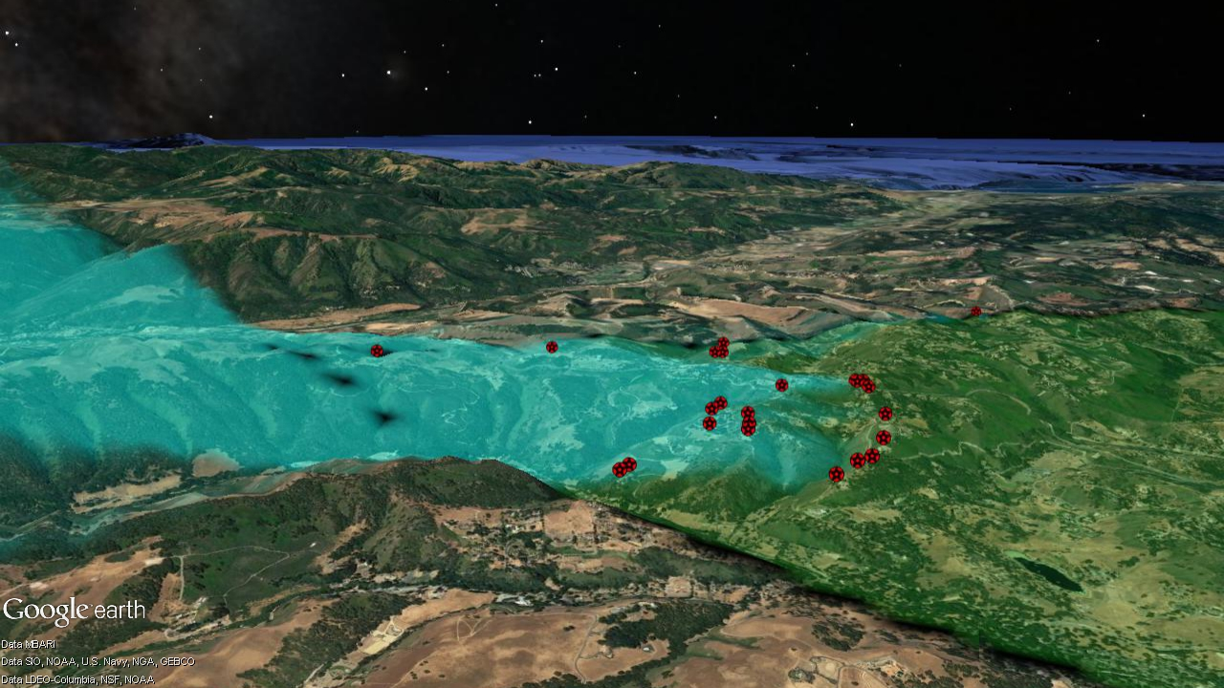
P2MP Deployment
Approximately 5 km
Base
Customers
Notes:
General overview of P2MP deployment area, looking west towards the Pacific Ocean
Base points north (right); emissions are within green beam (same colors used in cartoon)
Customers/CPE are the red dots, whose blue beams point back at the base

Slide 27
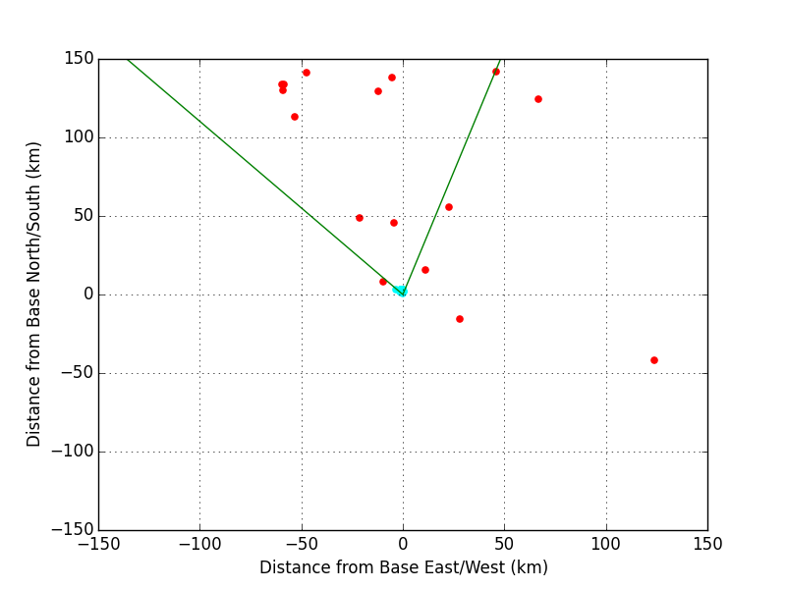
FSS
P2MP
P2MP Base Station Beam
Entire P2MP deployment is confined to blue area
Notes:
Overview of where FSS are with respect to P2MP deployment

Slide 28
P2MP Characteristics
Base height: 9.1 m AGL
CPE height: 4.6 m AGL
Bandwidth: 10 MHz
Conducted Power (base and CPE): 30 dBm
Antenna Gain (base): 17 dBi
Antenna Gain (CPE): 16 dBi
Base horizontal beamwidth: 60 deg
CPE horizontal beamwidth: 40 deg
Notes:
Assumptions about 3.7 GHz replacement/overlay uses CBRS Cat B EIRP levels

Slide 29
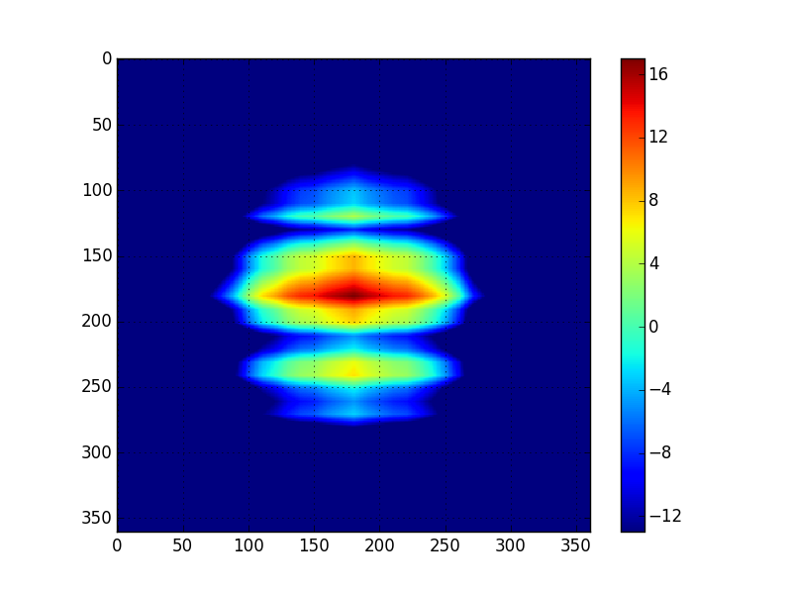
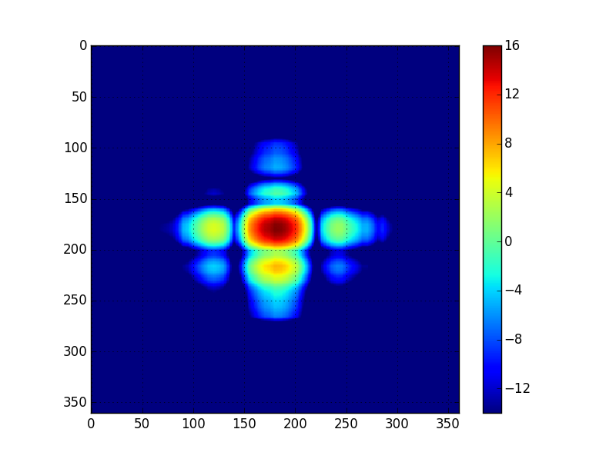
P2MP Antenna Patterns
Gain (dBi)
Gain (dBi)
Base
CPE
EL
EL
AZ
AZ
Notes:
Two-dimensional (azimuth/elevation) antenna profiles for P2MP system, if interested

Slide 30
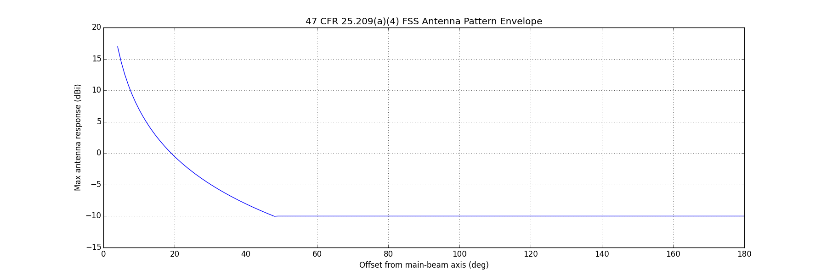
FSS Characteristics
Lat/lon as confirmed by imagery
Feed point height as registered and confirmed by imagery
Antenna gain pattern envelope: 47 CFR 25.209(a)(4)

Slide 31
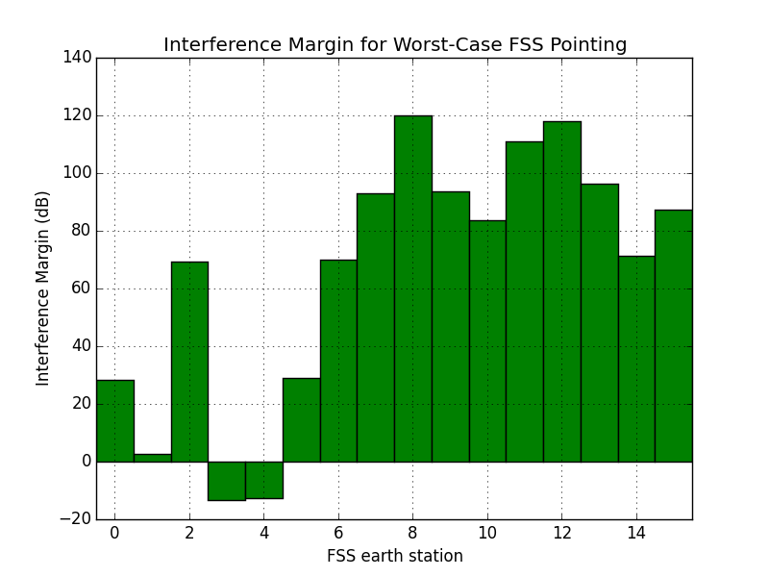
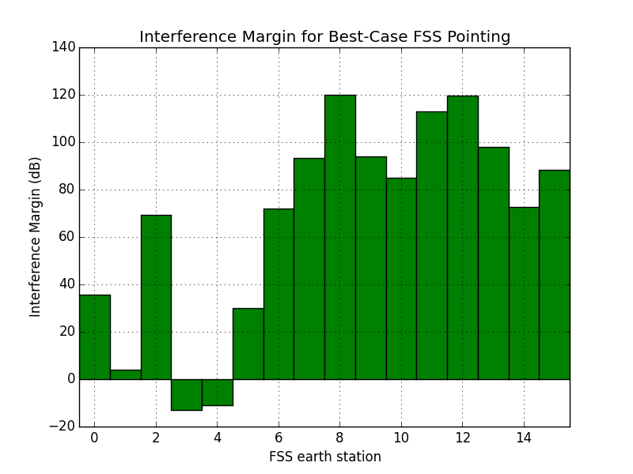
Results: Co-Channel Interference Margin
In most cases, the FSS interference criterion is met by tens to well over 100 dB. In two cases, the interference objective is not met under the default assumptions.
Notes:
Worst and best cases are with respect to pointing of the individual FSS earth stations across their registered GSO range
Typically doesn’t make much difference. FSS 0 is the biggest difference. It’s closest to P2MP, but outside any of the P2MP beams. Total swing from worst-case to best-case is only about 7 dB. The rest are much smaller, if any.

Slide 32
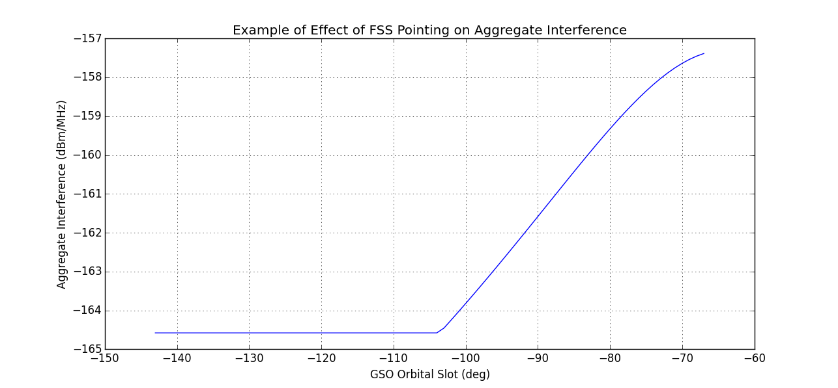
Aggregate Interference vs FSS Pointing
FSS site 0 is to the NW of P2MP deployment
Notes:
As FSS points farther east, the P2MP signals moves into closer sidelobes of the FSS dish

Slide 33
FSS
P2MP
P2MP Base Station Beam
Earth stations for which interference criterion is not met
Notes:
The two earth stations for which interference criterion is not met are ~40-50 km away, but in main beam of antenna, and essentially LOS as far as ITM knows.
Let’s take a closer look.

Slide 34
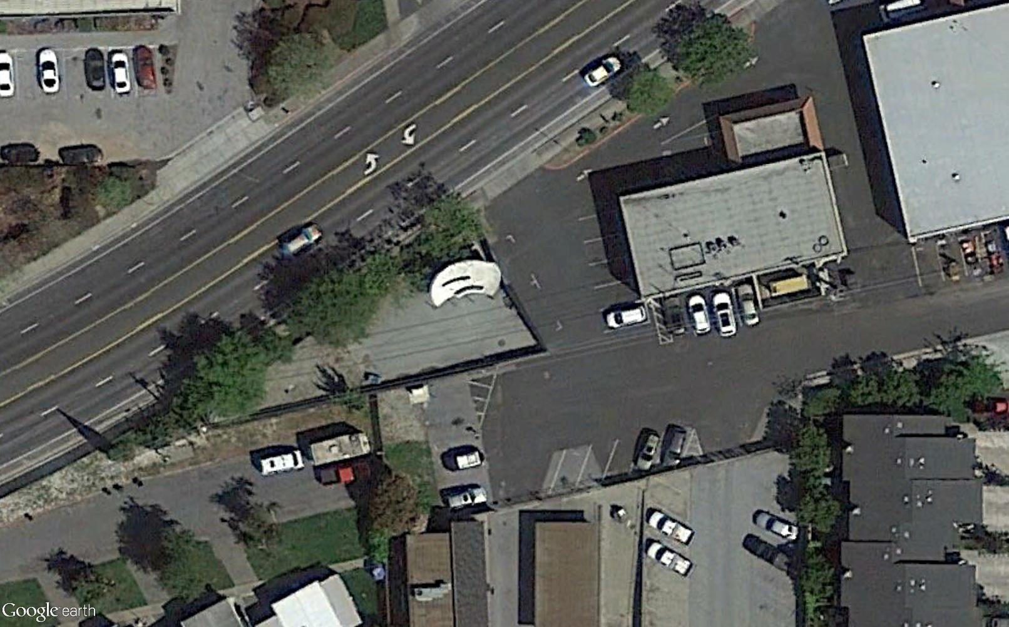
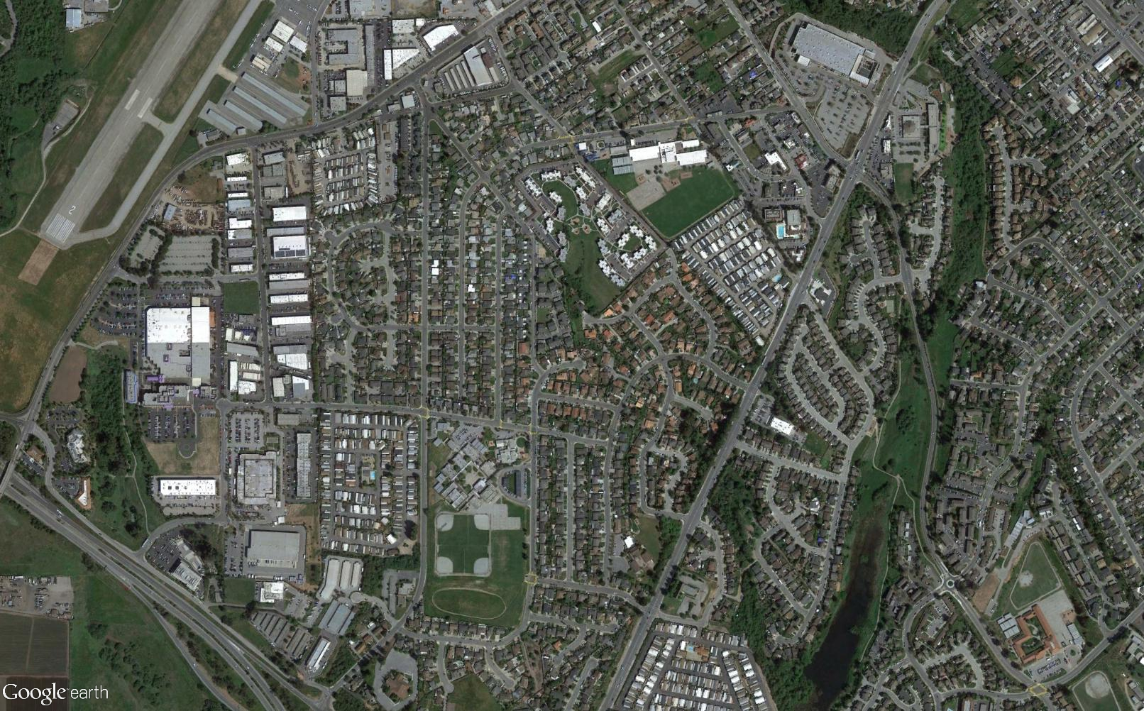
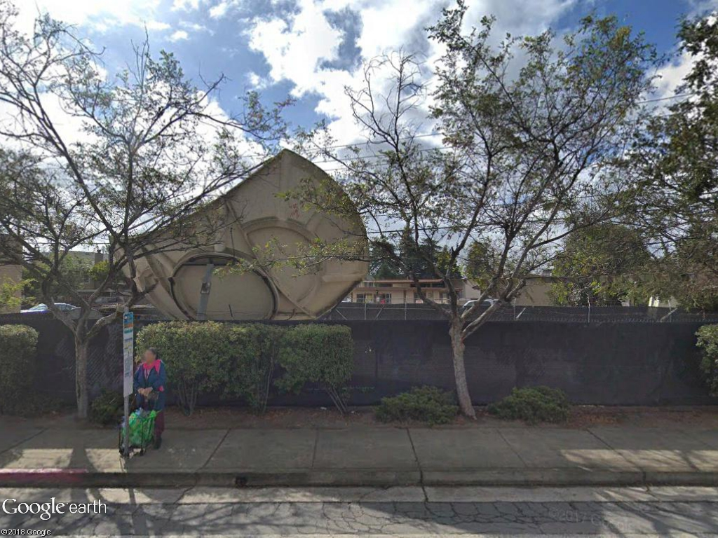
First FSS site over interference criterion
Over margin by 13.4 dB
Have met with operator to discuss nature of their operations
  Most of their needs are now met by fiber
  Use of FSS is limited to “a small portion of the upper part of the band”
Potentially significant clutter loss in real-world propagation
  Elevation to base antenna: 0.6 deg
  Surrounding clutter exceeds path elevation
  Needed clutter loss (~14 dB) is very small compared to observed clutter losses in measurements
Direction to P2MP base (46 km)
Notes:
Remember, over 1-5 km, we saw 40-60 dB of clutter loss over ITM in our measurements

Slide 35
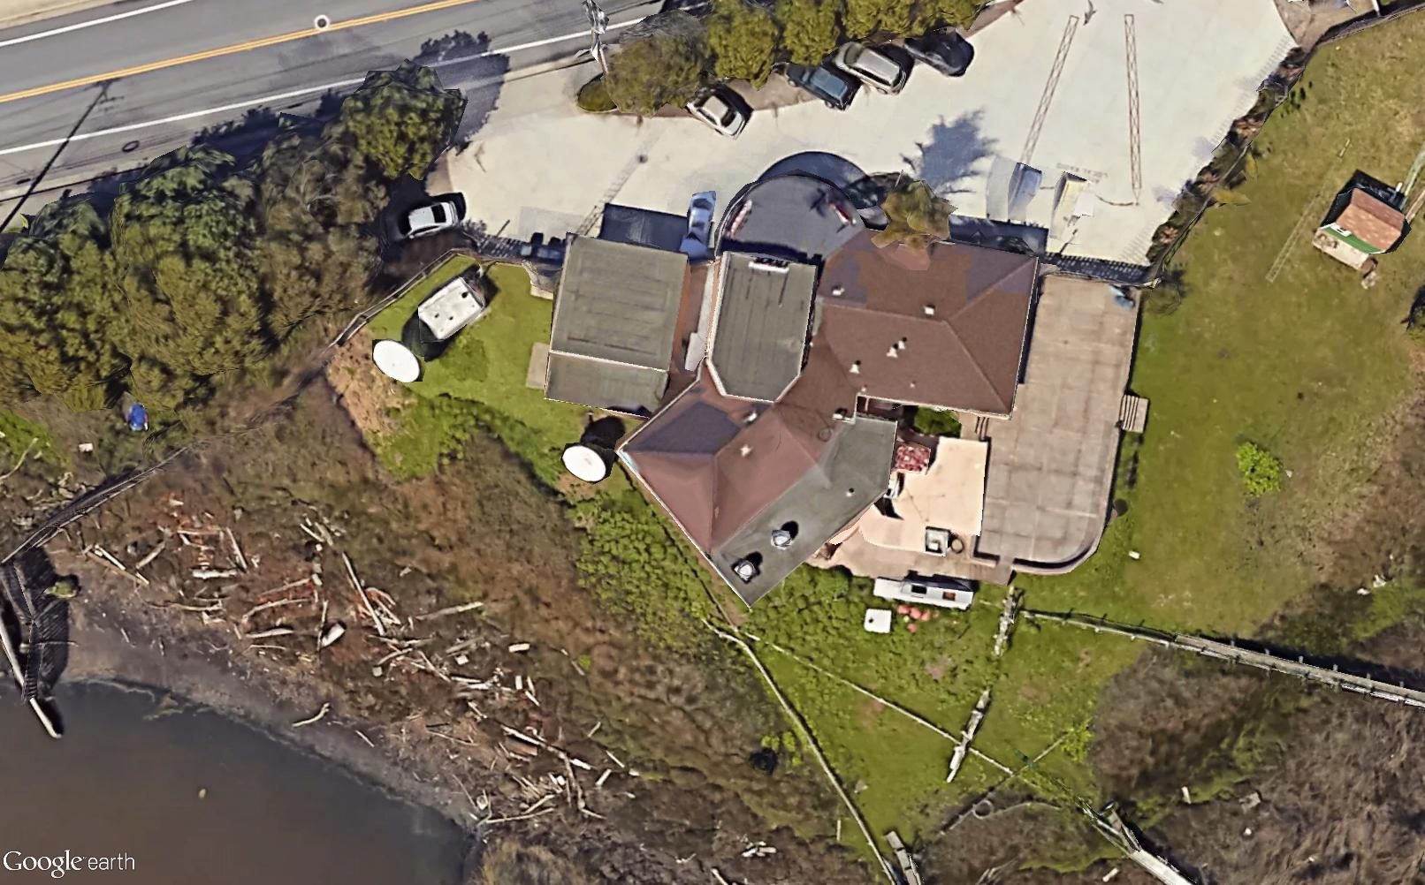
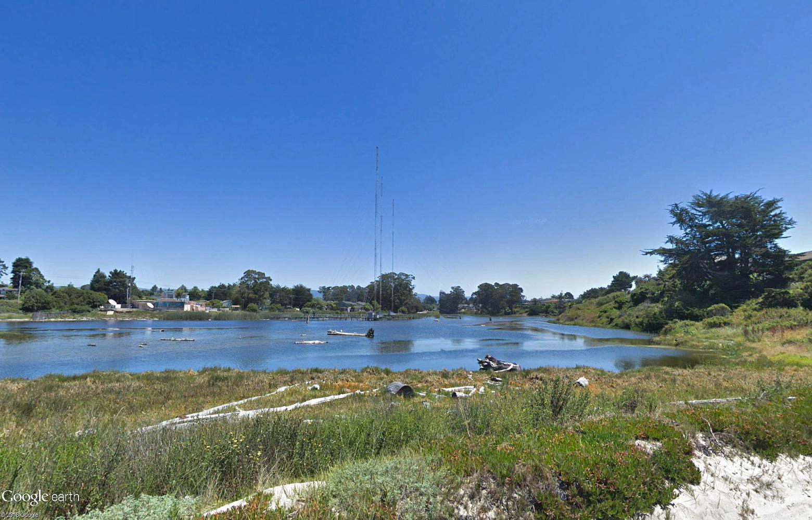
Second FSS site over interference criterion
Over margin by 12.7 dB
0.5 deg elevation to base; clutter likely a strong factor
Site operated by licensee that uses only 23 MHz of spectrum at one carrier frequency, despite being registered for 500 MHz of spectrum
Side view showing elevation to P2MP base
Elevation towards base
FSS
Direction to P2MP base (53 km)
Notes:
Similar situation to previous

Slide 36
Impact of Frequency Separation
Although propagation and clutter losses likely clears all 500 MHz of spectrum for co-channel P2MP use in this specific scenario, the two earth stations that require additional study both limit their frequency use (one uses 23 MHz of spectrum, the other uses a “limited range of frequencies near the top of the band.”)
If frequency separation is taken into account, interference objective is different since fundamental P2MP emissions would be placed outside of the frequency range being received by the earth station
Relevant interference criteria become:
  Blocking interference: keeping the overall signal strength low enough so as not to cause overload of the earth station’s front end. The blocking criterion for C-band FSS established in Part 96 is -60 dBm
  Out-of-band emissions: OOBE from P2MP appearing in-band for FSS. The objective is the same as for the co-channel case (-129 dBm/MHz), but the OOBE level for P2MP is much lower (by tens of dB) than the in-band power spectral density

Slide 37
Blocking Criterion
Blocking criterion: Total aggregate power of P2MP signals as received by FSS is less than −60 dBm
Assuming n P2MP transmitters each with transmit power P_{i} (dBm), the aggregate interference power I_{j} (dBm) is given by:
I_{j} = ∑(P_{i} + GT_{i,j} − PL_{i,j} + GR_{i,j}),
where (as before):
GT_{i,j} = Gain of P2MP antenna i in the direction of FSS earth station j
PL_{i,j} = Propagation loss from P2MP station i to FSS earth station j
GR_{i,j} = Gain of FSS earth station j’s antenna in the direction of P2MP station i
Relevant factor is total power, not power spectral density
n
i = 1

Slide 38
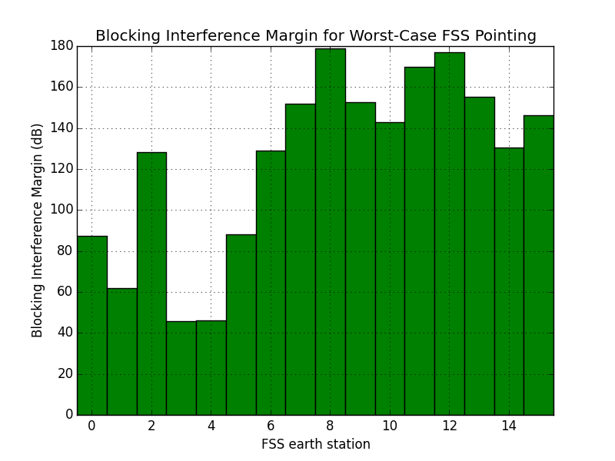
Results: Blocking Margin
Blocking criterion is met by a minimum of 45 dB, up to nearly 180 dB
Operating non-co-channel in this scenario is absolutely not a factor based on blocking criterion

Slide 39
Out-of-Band Emissions Criterion
OOBE criterion: Total aggregate OOBE power spectral density from P2MP signals as received by FSS is less than −129 dBm/MHz
Assuming n P2MP transmitters each with OOBE of OOBE_{i} (dBm/MHz), the aggregate interference power spectral density IPSD_{j} (dBm/MHz) is:
IPSD_{j} = ∑(OOBE_{i} + GT_{i,j} − PL_{i,j} + GR_{i,j}),
where (as before):
GT_{i,j} = Gain of P2MP antenna i in the direction of FSS earth station j
PL_{i,j} = Propagation loss from P2MP station i to FSS earth station j
GR_{i,j} = Gain of FSS earth station j’s antenna in the direction of P2MP station i
For this analysis, a worst-case OOBE level of -13 dBm/MHz is assumed
n
i = 1

Slide 40
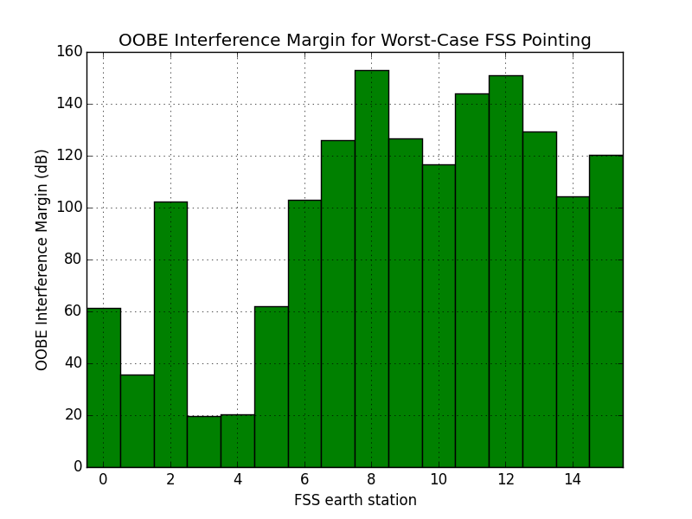
OOBE Margin Results
Assumed OOBE = -13 dBm/MHz
OOBE criterion is met by a minimum of ~20 dB, up to nearly 150 dB
Operating non-co-channel in this scenario is absolutely not a factor based on OOBE criterion

Slide 41
Non Co-Channel Summary
All interference margins are met by at least tens of dB when operating non-co-channel with FSS earth stations in the given scenario
Result is consistent with very small non-co-channel exclusion zones as computed in ITU-R Recommendation S.2199: “a few to several km” to protect against blocking, “a few km” to protect against OOBE
Assuming “a few to several km” means 10 km, as much as 40% of the U.S. population (~120 million Americans) could potentially be served by non-co-channel P2MP broadband.
Without accurate information on actual FSS frequency use, the true number cannot be determined.

Slide 42
Conclusions
3700-4200 MHz point-to-multipoint (P2MP) systems could immediately provide gigabit-class broadband service to tens of millions of Americans, without causing disruption to FSS
  In many areas of the country, P2MP systems can operate in C-band (3700-4200 MHz) without causing interference to co-channel fixed-satellite service (FSS) systems
  Co-channel sharing is possible by considering geographic and directional isolation between P2MP and FSS; that is, operating in areas with a relatively low number of earth stations, and using directional antennas that don’t point toward earth stations in the area.
If actual FSS frequency use were known, frequency separation could allow 25 Mbps - 1 Gbps P2MP broadband service to as many as 120 million Americans

