Slide 1
Readiness, Resources, and Resilience:
DoD’s REPI Program
Kristin Thomasgard
REPI Program Director
Office of the Assistant Secretary of Defense (Sustainment)
June 18, 2020

Slide 2
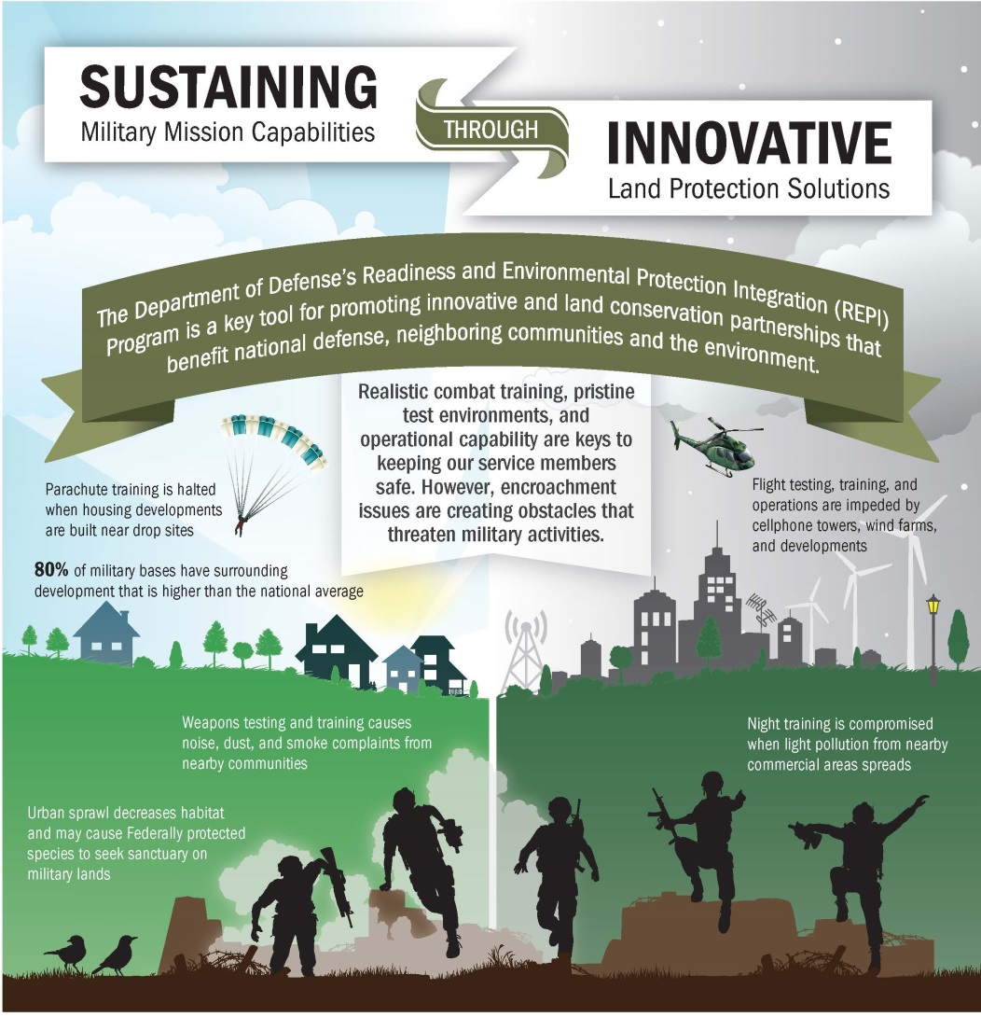

Slide 3
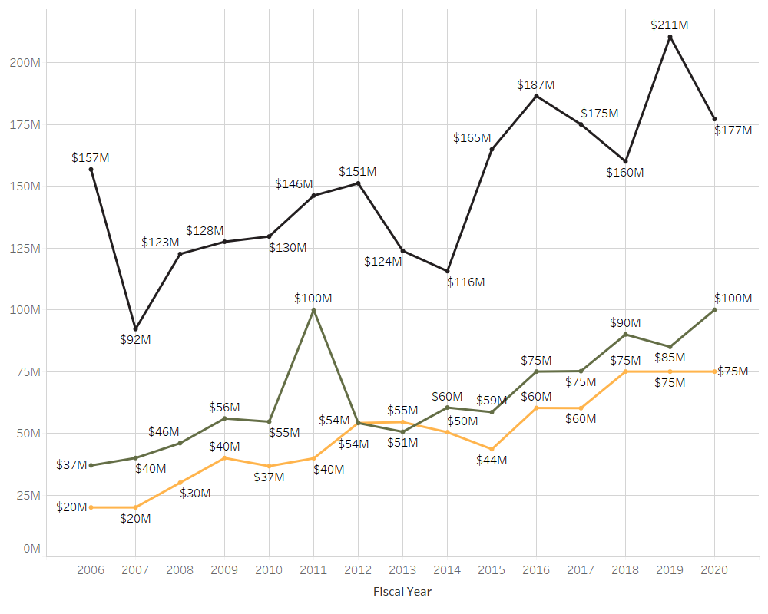
REPI Program Funding
Through FY2019, $962 million in DoD funds have been leveraged with $854 million in partner funds.

Slide 4
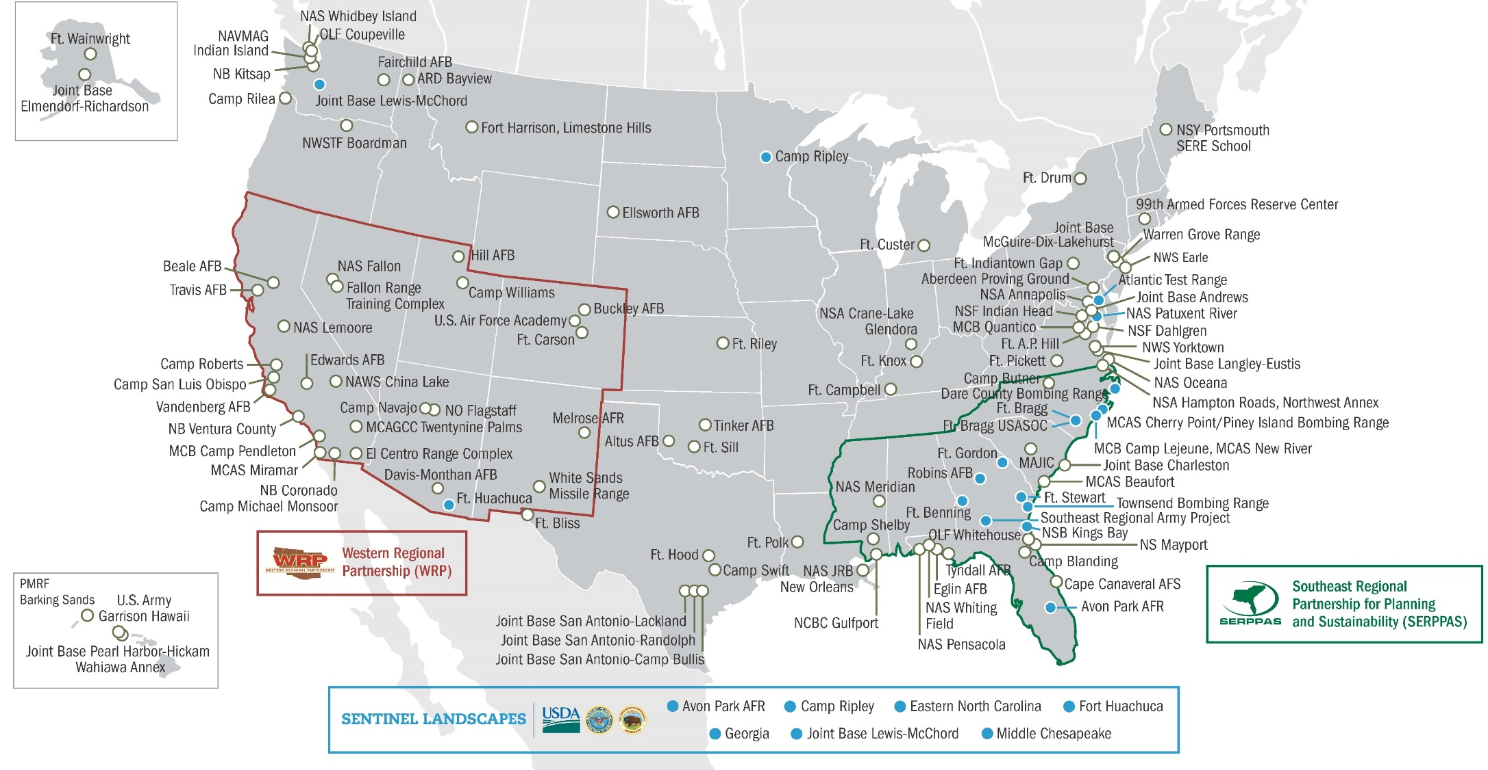
REPI Partnership Implementation
Notes:
Under REPI authority, over 688,000 acres have been protected to sustain military readiness at 110 installations in 33 states through compatible land use projects, landscape partnerships, and stakeholder engagement.

Slide 5
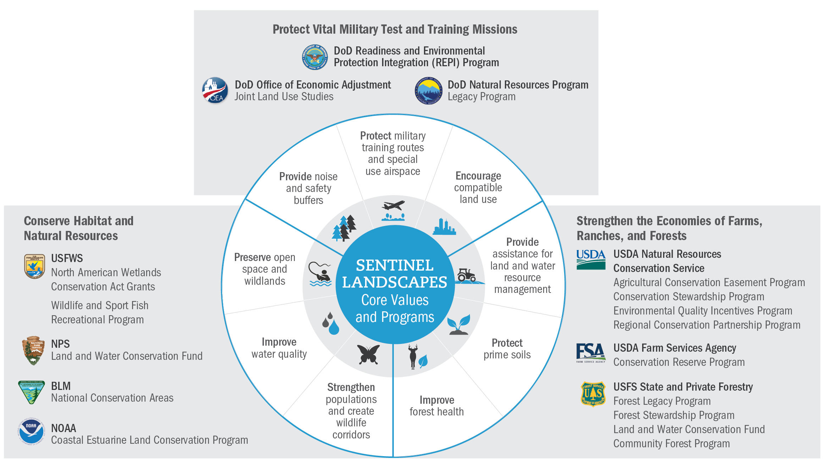

Slide 6
For more information:
Kristin Thomasgard
REPI Program Director
Office of the Assistant Secretary of Defense (Sustainment)
kristin.j.thomasgard.civ@mail.mil
571-372-6835 (office)
571-236-3100 (mobile)
www.REPI.mil
www.REPImap.org
www.SentinelLandscapes.org

